Slide 1

ALUMINIUM-AIR BATTERIES: Innovation in Energy Storage.
Project phase 1 presentation
Project Guide
Dr. S. B. Ghugare
Faculty
Department Of Chemical Engineering
AISSMS College of Engineering, Pune.
Krrishh Shirbhaiye
Student, BE Chemical
Department Of Chemical Engineering
AISSMS College of Engineering, Pune.

Slide 2
Contents
Introduction
Working.
Power Output Calculation.
Material Balance.
Energy Balance.
Advantages
Challenges
Applications.
References.

Slide 3

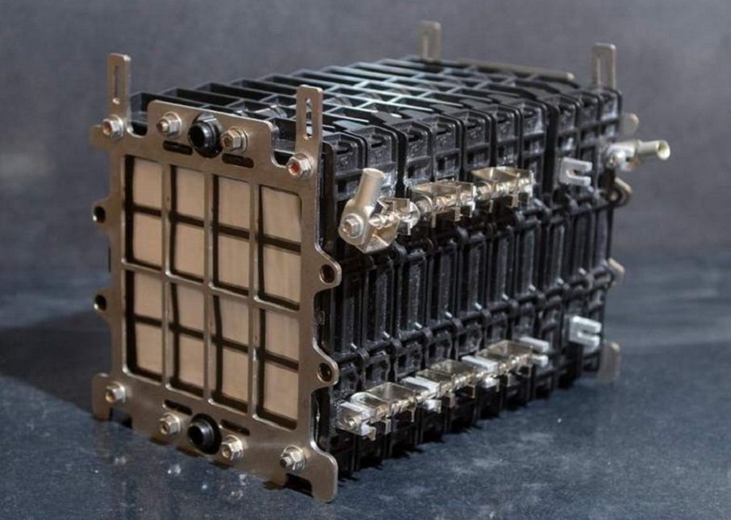
Introduction.
A metal-air electrochemical battery uses aluminum as the anode and oxygen from the air as the cathode. The battery generates electricity from the oxidation of aluminum with oxygen.

Slide 4
Working of Aluminum Air Battery.
Anode Reaction:
Aluminum (Al) reacts with hydroxide ions (OH⁻) to form aluminum hydroxide (Al(OH)₃) and release electrons.
Cathode Reaction:
Oxygen from the air reacts with water to form hydroxide ions (OH⁻) while accepting electrons.
Overall Reaction:
4Al+3O2+6H2O→4Al(OH)3+Electricity(2.71V)
Illustration of the battery structure:
Anode: Aluminum plate.
Electrolyte: Aqueous solution typically contains a strong base like potassium hydroxide (KOH).
Cathode: Porous air electrode.

Slide 5
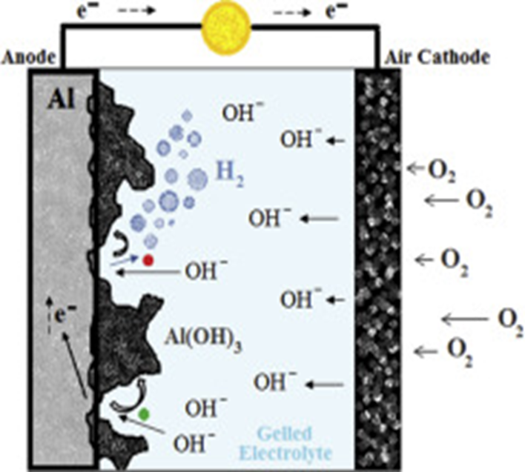
Assumptions & Requirements.
Mass of Aluminum = 1kg
Electrolyte = NaOH (20% by Weight)
Operating Temperature = 30C
Faraday’s Constant = 96485C/mol
Molar Mass of Aluminum = 27g/mol
Standard Energy Density = 8.1KWH/kg

Slide 6
Power Output Calculations.
1. Theoretical Current Calculation:
As Aluminum donates 3 electrons per atom,
Theoretical Output:
Mass of Aluminum=1kg (1000g)
using molar mass; mol of Al = 1000g/27g/mol
= 37.04 mol
So, the theoretical output of the battery with the assumed conditions should be 37.04 mol
Total Charge Available (C): 3 x Faradays Constant.
Q per mole = 3 x 96485C/mol.
= 289455C/mol
Therefore, the theoretical charge for 37.04mol will be;
37.04mol x 289455C/mol.
Qtotal= 10728513C.
Theoretical Current Output (A):
I theoretical = Q total/time (s)
= 10728513C/ 36000s = 298A
2. Actual Current Output:
In practice, the system experiences several losses:
Ohmic resistance in the electrolyte.
Parasitic reactions (Formation of aluminum hydroxides reduces efficiency).
Operating conditions (Temperature, electrolyte conditions, etc.)
Assume the practical efficiency is around 55%(Due to losses)
Therefore,
I actual = I theoretical x 0.55 = 298 x 0.55
= 164A
Therefore, the actual current output of the battery is 164A (assuming 55% efficiency)

Slide 7
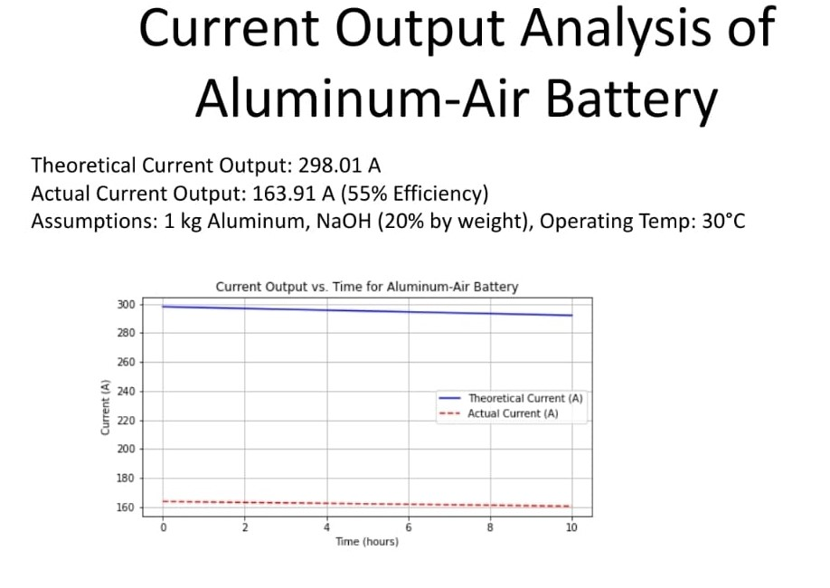
Graph of Power Output.

Slide 8
Material Balance.
Reaction: 4Al+3O2+6H2O→4Al(OH)3+Electricity(2.71V).
Molar Mass of Al = 27g/mol.
Molar Mass of 4Al(OH)3 = 78g/mol.
Now,
Moles of Al = 1000g/27g/mol
= 37.04g
Now,
4 moles of Al reacts with 3 moles of O2.
Therefore, moles of oxygen = 3/4 x 37.04
= 27.78mol
Molar mass of oxygen = 32g/mol
Now,
Mass of Oxygen = 27.78 x 32
= 888.96g
= 0.89kg
Now,
For every 4 moles of Al, 6 moles of H2O are consumed.
the moles of water required are:
Moles of H2​O= 46​ x 37.04
=55.56mol.
Molar mass of H2​O = 18 g/mol.
The total mass of water used is:
Mass of H2​O=55.56×18
=1000g =1kg
Now,
4moles of aluminum produce 4 moles of aluminum hydroxide
Thus, the total moles of aluminum hydroxide formed are:
Moles of Al(OH)3 = 37.04mol
The corresponding mass of aluminum hydroxide is:
Mass of Al(OH)3 = 37.04 x 78
= 2889.12g = 2.89Kg

Slide 9
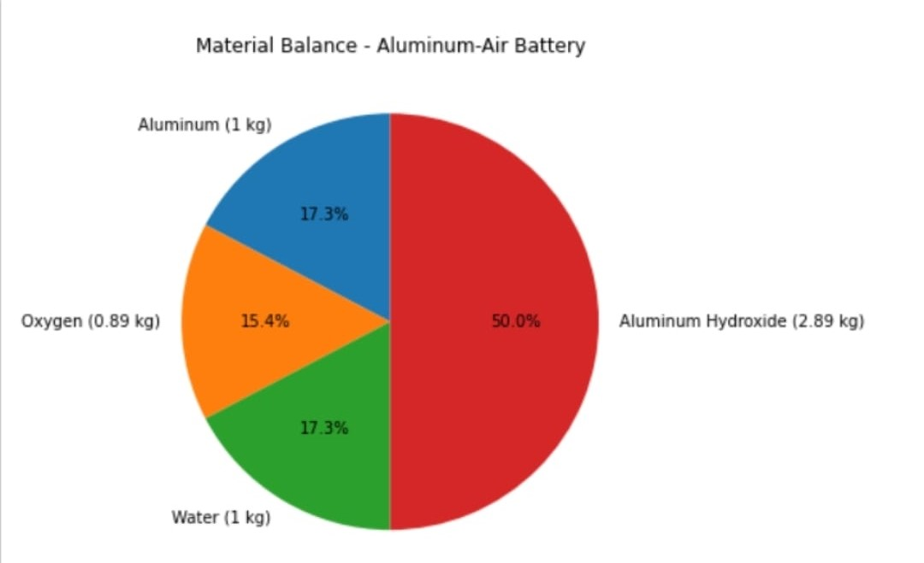
Pie Chart for Material Balance.

Slide 10
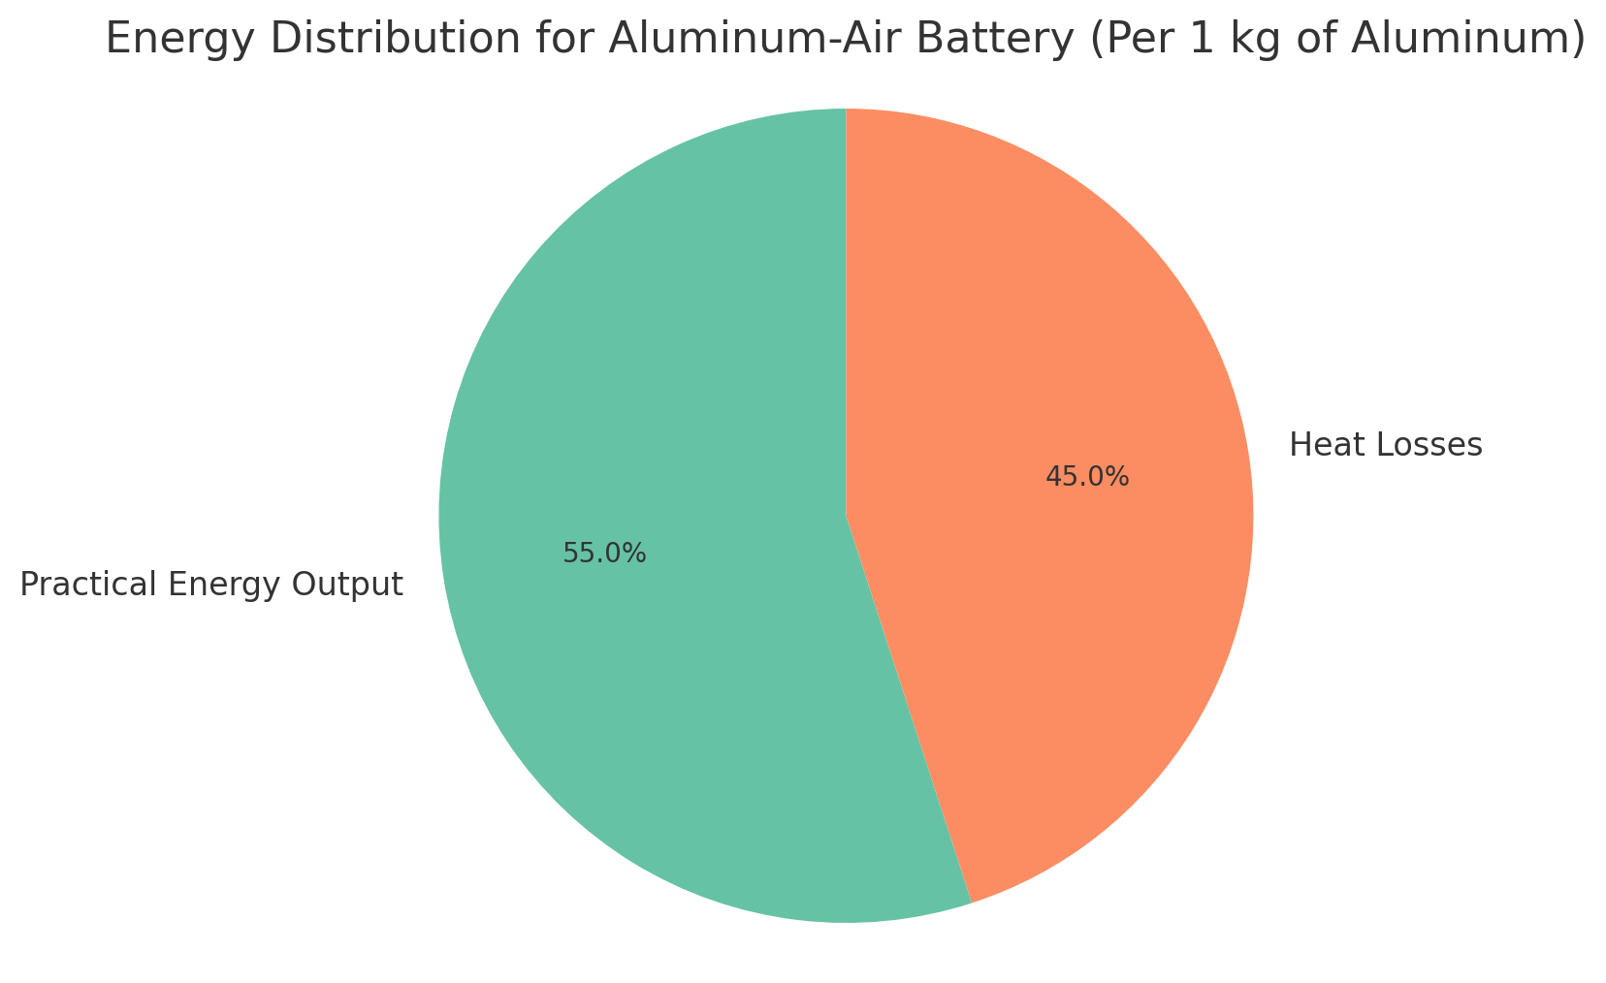
Energy Balance.
Step 1: Theoretical Energy Output:
The theoretical energy density of aluminum is 8.1 kWh/kg.
For 1 kg of aluminum: Theoretical Energy =8.1kWh =29160kJ
Step 2: Practical Energy Output:
Considering 55% efficiency due to losses (Ohmic, parasitic reactions, etc.)
Practical Energy =0.55×8.1kWh =4.455kWh
=16038kJ
Step 3: Heat Losses:
The heat lost due to inefficiencies is the difference between theoretical and practical energy:
Heat Lost =29160kJ−16038kJ
=13122kJ

Slide 11
Summery.
Power output:
Material Balance:
Energy Balance:
Theoretical Current Output: 298 A
Actual Current Output: 164 A (assuming 55% efficiency).
Aluminium consumed: 1 kg
Oxygen consumed: 0.89 kg
Water consumed: 1 kg
Aluminum hydroxide produced: 2.89 kg
Theoretical Energy Output: 29160 kJ(8.1kWh)
Practical Energy Output:16038 kJ(4.455 kWh)
Heat Lost:13122kJ

Slide 12
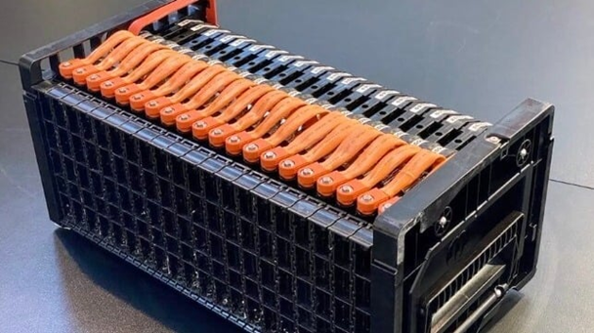
Advantages.
High Energy Density.
Lightweight and Cost-Effective
Environmentally Friendly
Simplicity

Slide 13

Challenges.
Limited Rechargeability
Corrosion Issues
Limited Power Output

Slide 14
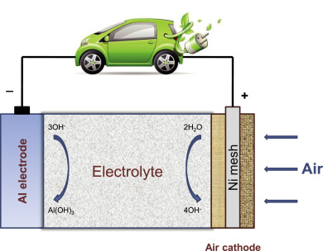
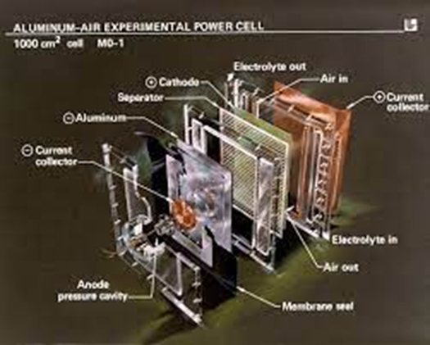
Applications.
Electric Vehicles (EVs).
Backup Power.
Military Use.
Remote Locations.

Slide 15
References.
[1] Aluminum Air Battery: How Do They Work? Link to Article:
https://www.slideshare.net/slideshow/aluminum-air-battery-how-do-they-work-plus-diy/238948572
[2] Real-World Testing of Aluminum-Air EV Battery Underway. Link to Article:
https://www.motorbeam.com/real-world-testing-of-aluminium-air-ev-battery-underway/
[3] Industrial Battery Comparison:
https://r5.ieee.org/houston/wp-content/uploads/sites/32/2020/03/Battery-Technology-Comparison-IEEE-2020.pdf
[4] Comparison of commercial battery types (Wikipedia):
https://en.wikipedia.org/wiki/Comparison_of_commercial_battery_types
[5] Power Sonic's Guide:
https://www.power-sonic.com/blog/lithium-vs-lead-acid-batteries/

Slide 16
References.
[6] Cloud Energy Blog: Expert Insights on Lithium Battery: Lithium-Ion Battery vs Lead Acid Battery: A Comprehensive Comparison:
https://www.cloudnewenergy.com/blogs-detail/lithium-ion-battery-vs-lead-acid-battery
[7] Lithium-ion vs. Lead-acid: Performance, Costs, and Durability:
https://renewablesadvice.com/battery/lithium-ion-vs-lead-acid/
[8] Tycron Energy:
https://www.takomabattery.com/aluminum-air-battery-2/
[9] Aero Toolbox:
https://aerotoolbox.com/aircraft-lead-acid-battery/
[10] Ufine Blog:
https://www.ufinebattery.com/blog/how-does-a-lithium-ion-battery-work/

Slide 17
References.
[11] Energy Connects:
https://www.energyconnects.com/news/renewables/2021/july/a-major-ev-battery-bet-for-india-is-on-aluminum-over-lithium/
[12] Autocar Professional:
https://www.autocarpro.in/news/indian-oils-aluminium-air-battery-manufacturing-jv-readies-itself-for-manufacturing-rollout--113826
[13] Hindustan Times Auto:
https://auto.hindustantimes.com/auto/electric-vehicles/how-locally-made-aluminum-air-batteries-may-be-big-boost-to-ev-adoption-in-india-41658221897220.html
[14] Clean Energy Institute, University of Washington:
https://www.cei.washington.edu/lesson-plans/aluminum-air-battery/#:~:text=Aluminum%20air%20batteries%20use%20aluminum,types%20of%20battery%20electrode%20materials.

Slide 18
THANK YOU

